Slide 1
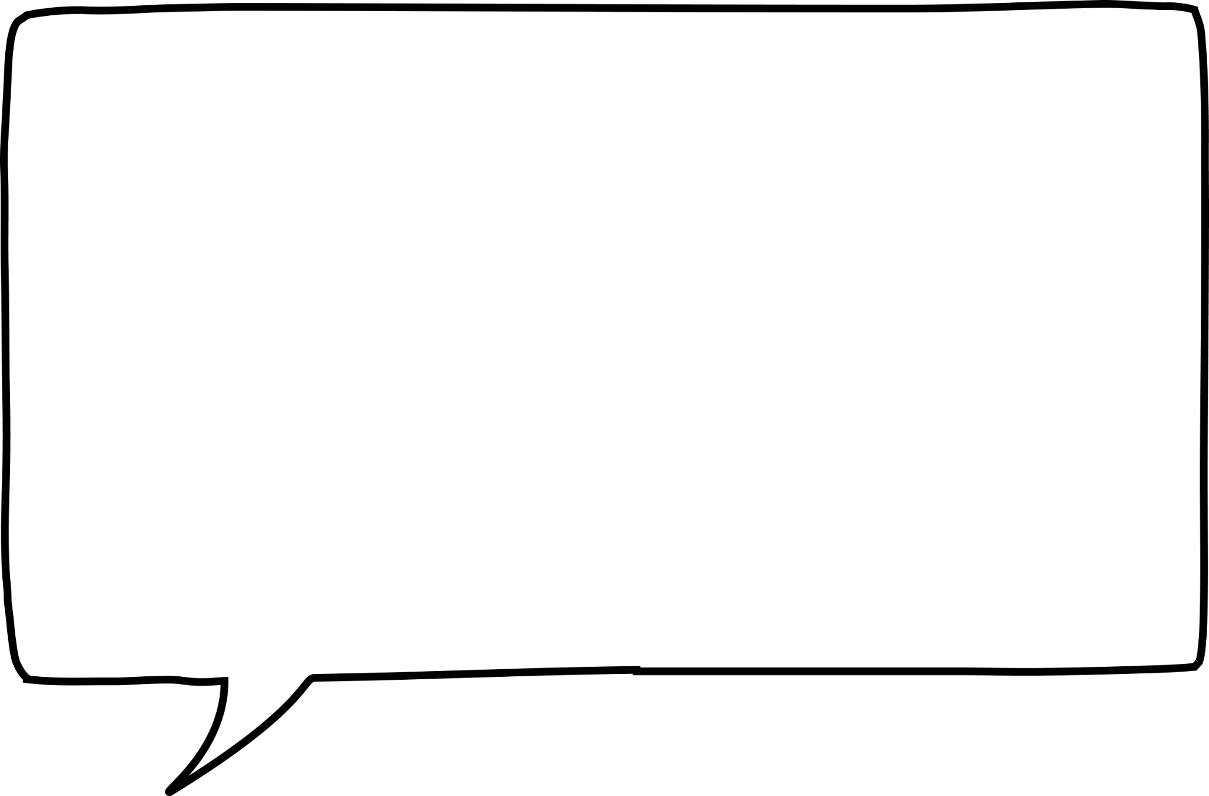
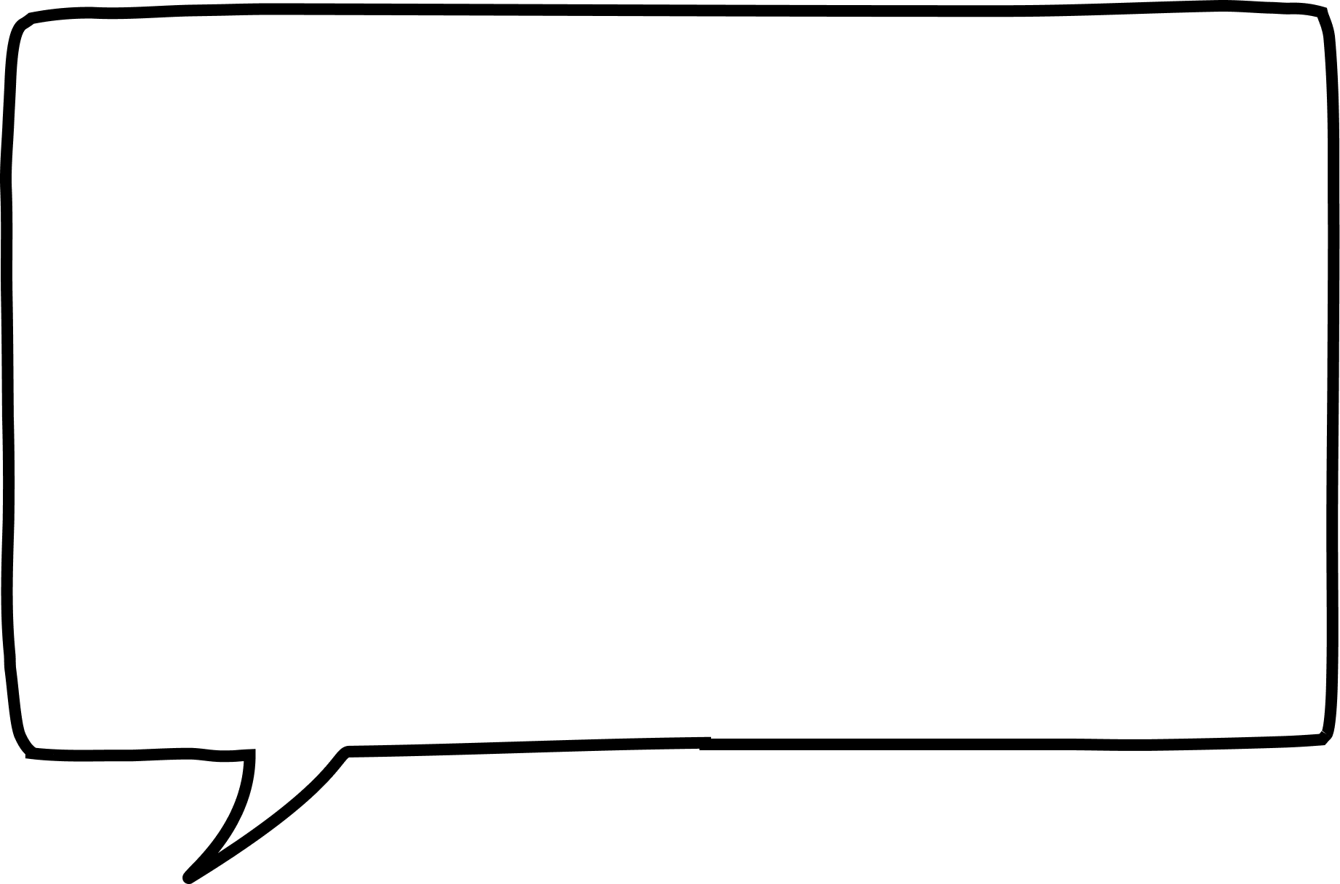
Square and cube numbers
Task A: Square numbers
Match up the arrays with the correct square number.
16
25
64
49
2) Work out the age given the clues.
My teacher’s age is:
a square number,
a multiple of 3,
and less than 70.
Alex is a student at Oak Academy.
Alex’s age is:
4 less than a square number and is an even number.
How old is the teacher?
How old is Alex?
3) Identify if the following statements are true or false. Justify your answer.
Statement | True | False | Justification
121 is a square number
13 ✕ 13 = 169 so 13 is a square number
4 add 3 then multiply by 7 gives a square number
7 multiplied by 4 then add 3 gives a square number

Slide 2
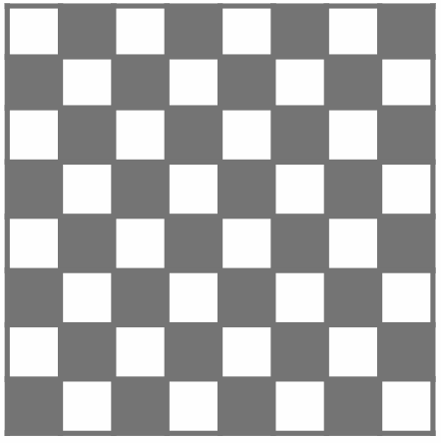
Square and cube numbers
4) Jun discovers he can sum two different square numbers to make a third square number.
Can you find the missing square numbers to complete this table?
1st square number | 2nd square number | Resultant square number
9 | 16 | 25
 |  | 100
 |  | 169
Can you find another set of two different square numbers to make a third square number?
5) How many squares can you see on an 8 by 8 chess board?
Task B: Cube numbers
Identify all the cube numbers from the list below.
1 2 3 4 8 9 10
16 25 27 36 40 49
64 100 121 125 169
1000
2) Put the following numbers in the Venn diagram:
1 3 4 8 9
16 25 27 36 40 49
64 125 216 1000
Square numbers
Cube
numbers
Mathematics in Education and Industry
v2.1

Slide 3
Square and cube numbers
3) Fill in the number to make the calculation correct.
The number in the SQUARE is a square number
The number in the CUBE is a cube number.
⬜ + 🧊 = 31
⬜ + 🧊 = 33
⬜ + 🧊 = 225
⬜ + ⬜ + 🧊 = 104
🧊 + 🧊 + 🧊 = 36
Mathematics in Education and Industry
‹#›

